Slide 1


Slide 2


“Predictive Analysis for Travel Insurance” through Machine Learning By - Mehtaab Shaikh
CAPSTONE PROJECT

Slide 3
Introduction
Greetings to all guests for our presentation on “Predictive Analysis for Travel Insurance through Machine Learning”.
Our project aims to use the database history of around 2000 former clients from a well-known tours and travel company to forecast their potential interest in purchasing travel insurance in the future. We seek to develop an intelligent model capable of predicting a customer's likelihood to purchase the travel insurance package based on specific characteristics.
These variables comprise the client's age, profession, level of education, yearly income, size of family, frequency of travel, health condition, past international travel history, and number of prior travel insurance purchases.
We will explore the important steps used to examine the data, identify significant trends, and to create predictive models throughout the session. Upon completion, you will have a deeper understanding of the variables impacting consumer reactions and how these understandings can inform focused marketing tactics.
By - Mehtaab Shaikh

Slide 4
Importance of Travel Insurance
Financial Safety Net
Travel insurance provides a safety net in the event of unexpected events, ensuring that passengers won't be stranded paying high medical costs or suffer financial loss caused due to cancelled flights.
Emergency Assistance
It includes access to emergency assistance services, such as medical evacuations or repatriation, in the event of a medical emergency.
Peace of Mind
It provides peace of mind, allowing travelers to enjoy their trip knowing they are protected against unexpected mishaps.
Join us as we explore how smart algorithms can provide a more secure and personalized travel coverage experience.
By - Mehtaab Shaikh

Slide 5
Overview of Machine Learning
Pattern Recognition It focuses on training computer systems to identify patterns and make decisions based on data, leading to more accurate predictions and outcomes
Data Analysis Machine learning involves using algorithms to analyze and interpret complex data sets, enabling the discovery of meaningful patterns and insights.
Risk Mitigation It helps in identifying and mitigating potential risks through the analysis of historical data and real-time information, leading to more accurate risk assessments and appropriate coverage.
Customized Recommendations Machine learning enables the customization of travel insurance options based on individual travel patterns and preferences, enhancing coverage and satisfaction
By - Mehtaab Shaikh

Slide 6

Data Collection
The firm has supplied data about its prior clients, which consists of ten columns,
for this research.
Descriptive Statistics
Number of Rows – 1,987
Number of Columns – 10
Key Input Variables
Age – The customer’s age
Employment Type - The Industry in which the customer works
Graduate or Not - This refers to the customer's status as a college graduate
Annual Income - The customer’s annual income expressed in Indian rupees
Family Member – The customer’s Family size
Chronic Diseases – To know if the customers has any serious medical conditions
Frequent Flyer - To know how many customer are a frequent traveler
Ever Travelled Abroad - To know if the customers ever traveled overseas
Travel Insurance - To know if the customers bought the Travel Insurance
Outcome variable
Binary Classification task determining whether the customer possesses travel insurance. (0 and 1)
By - Mehtaab Shaikh

Slide 7
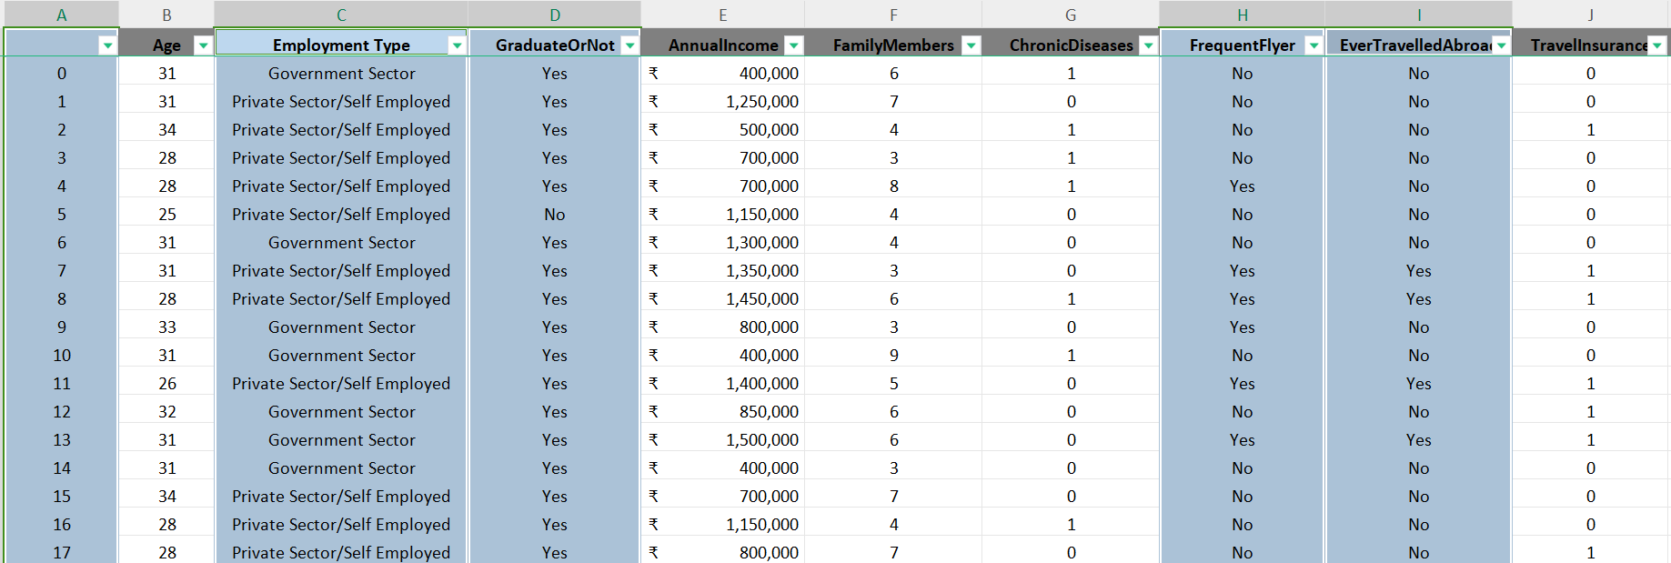
Data Preprocessing
After receiving the data, certain modifications were implemented to clean it up. Handling Missing Values The dataset underwent filtration to identify discrepancies or missing values. No gaps or missing data were identified. Removing Column An unnamed column was identified and removed during subsequent machine learning analysis, and its indexing for dashboard presentation was adjusted to start at 1 instead of 0. Converting data Additionally, four columns, namely (Employment Type, Graduate or Not, Frequent Flyer and Ever Travelled Abroad) indicating categorical data, were converted to numerical format to enhance clarity and improve model performance.
By - Mehtaab Shaikh

Slide 8
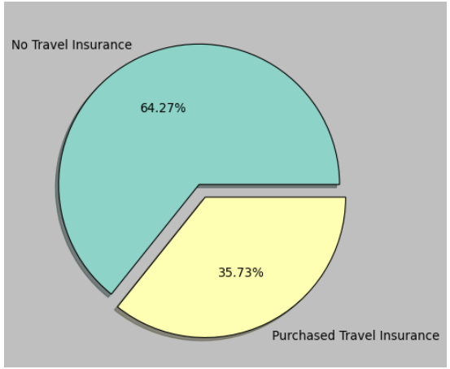
Visualization in machine learning not only aids in understanding data and model behavior but also facilitates effective communication of results to stakeholders. It helps make informed decisions, troubleshoot issues, and build trust in machine learning models.
Illuminating Patterns and Trends
Out of the company's 1987 customers, only 35.73% opted to purchase the travel insurance package.
Based on the pie chart shown, it's evident that the distribution of our target variable is significantly skewed.
By - Mehtaab Shaikh

Slide 9
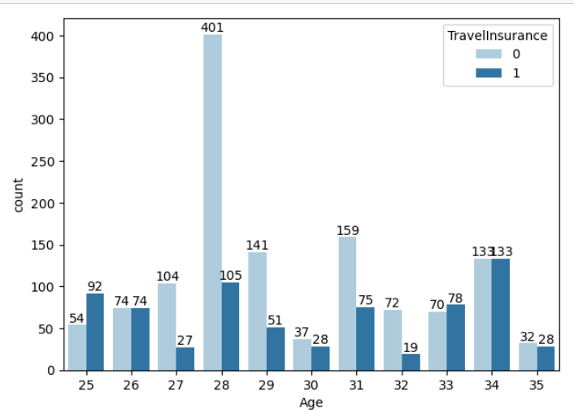
Based on the graph analysis, it's evident that the peak buying age is 34, while the lowest purchase ages across all age groups are consistently observed at 27, 30, and 32. Furthermore, the data indicates that the age range of applicants spans from a minimum of 25 years to a maximum of 35 years.
AGE
By - Mehtaab Shaikh

Slide 10
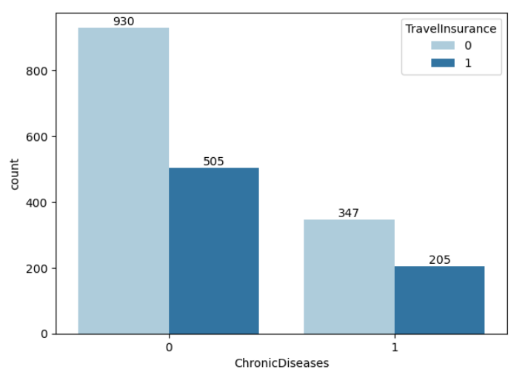
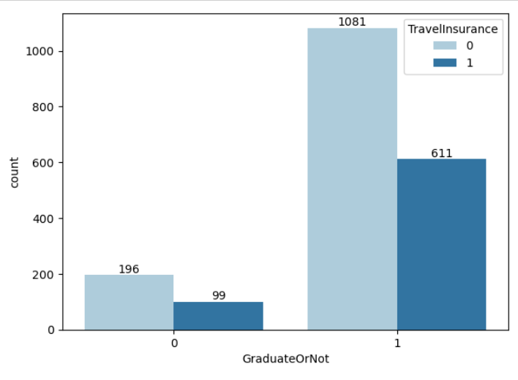
The business seems unaffected by chronic diseases, suggesting they do not exert a significant impact. Additionally, a noteworthy observation is that a majority of customers purchasing travel insurance hold a graduate degree.
Chronic Diseases
Graduate or Not
By - Mehtaab Shaikh

Slide 11
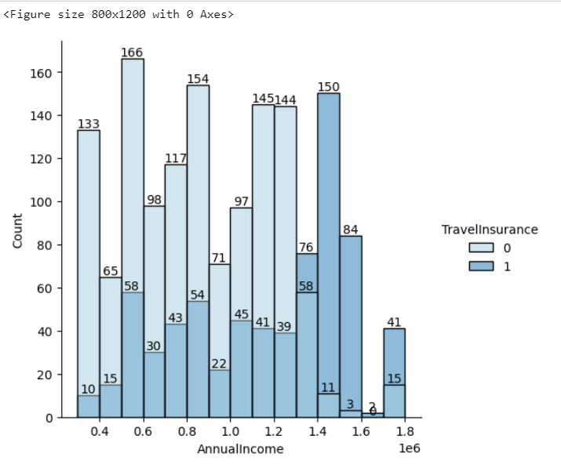
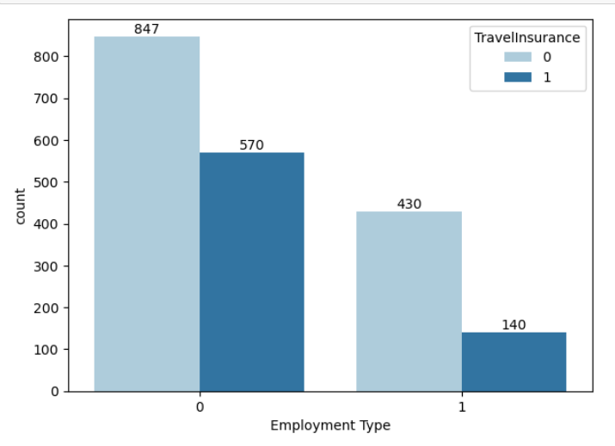
The data reveals a strong inclination for individuals earning approximately ₹14,00,000 per year to opt for travel insurance. Additionally, there is a notable trend where customers employed in the private sector show a higher propensity to purchase Travel Insurance packages.
Annual Income
Employment Type
By - Mehtaab Shaikh

Slide 12
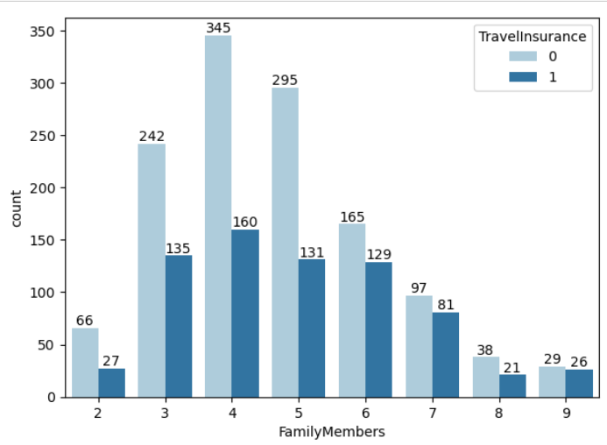
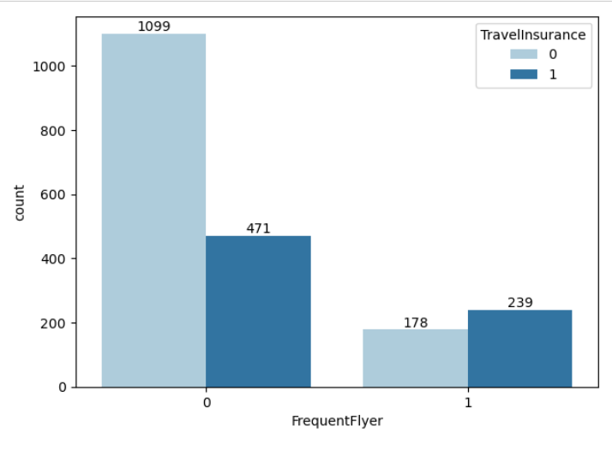
The data suggests that frequent travelers are more inclined to purchase travel insurance. Moreover, individuals with a family size of four members emerge as the primary demographic with the highest likelihood of acquiring travel insurance.
Family Members
Frequent Flyer
By - Mehtaab Shaikh

Slide 13
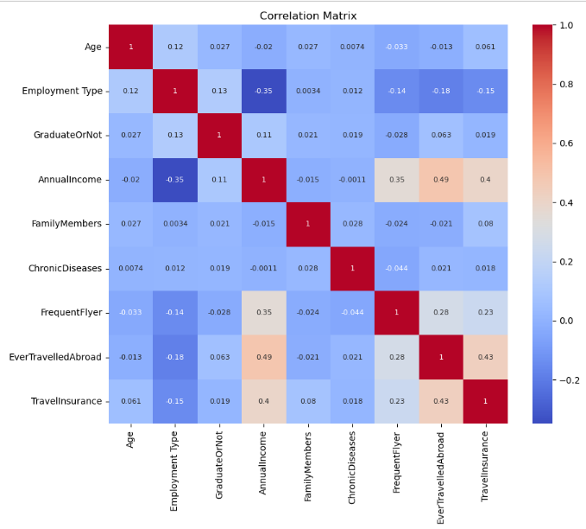
The features most strongly correlated in the dataset are Ever Travelled Abroad, Annual Income, Frequent Flyer status, Employment Type and the number of Family Members. Theses factors exhibit a notable degree of correlation within a given data.
Correlation Matrix
By - Mehtaab Shaikh

Slide 14
Model Selection
Selection of Machine Learning Algorithms for Prediction
Logistic Regression
Commonly used for binary classification problems and can provide insights into the probability of travel insurance claims occurring.
Random Forest Classifier
Random Forest is a popular choice for classification because it combines multiple decision trees, resulting in high accuracy and reduced overfitting. It is suitable for handling complex datasets, including categorical and numerical variables.
XGBoost Classifier
An iterative technique known for its performance and ability to identify complex interactions in the data.
Decision Tree Classifier
Decision trees are chosen for their simplicity, interpretability, and ability to handle both categorical and numerical data. They are effective for capturing complex relationships, require minimal data preprocessing, and are robust to outliers
Naïve Bayes Classifier
Naive Bayes is often chosen for its simplicity, efficiency, and effectiveness in text classification and other tasks. It works well with high-dimensional datasets, requires fewer parameters to tune, and can handle large amounts of data.
By - Mehtaab Shaikh

Slide 15
Model Training and Evaluation Process
Data Splitting
The dataset is divided into training, validation, and testing sets to ensure unbiased model evaluation.
Model Training
Utilization of various machine learning models to identify the most fitting algorithm for the prediction task.
Evaluation Metrics
Measuring model performance using metrics like accuracy, precision, recall, and F1 score.
By - Mehtaab Shaikh

Slide 16
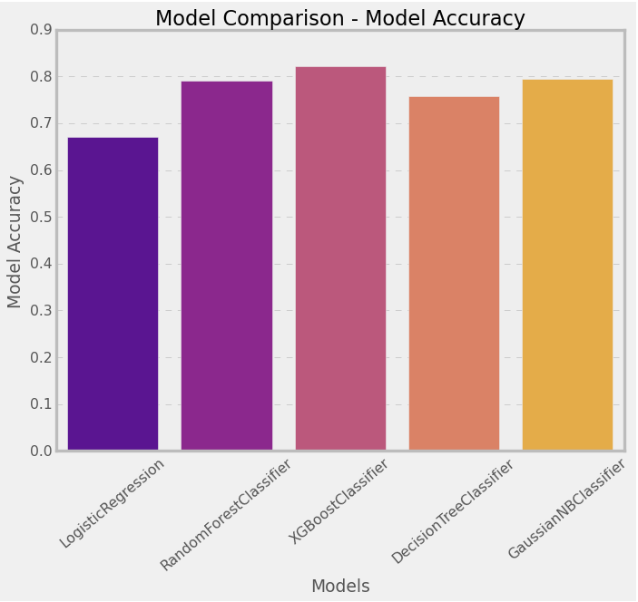
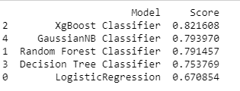
Model Comparison
Following a thorough assessment of different models, the XGBoost Classifier emerged as the most effective algorithm for our travel insurance prediction task. XGBoost proves to be the optimal choice for our predictive model, offering superior accuracy, resilience, and capability in managing the intricacies of the dataset.
By - Mehtaab Shaikh

Slide 17
Performance Metrics
Accuracy Rate – 82%
Represents the proportion of correctly predicted Travel Insurance Analysis.
F1 Score – 87%
Considers both the precision and recall rates, providing a balanced evaluation of the prediction model.
Overall Model Performance
XGBoost Classifier attained the highest accuracy among all models. Exhibited exceptional precision, recall, and F1 score.
By - Mehtaab Shaikh

Slide 18
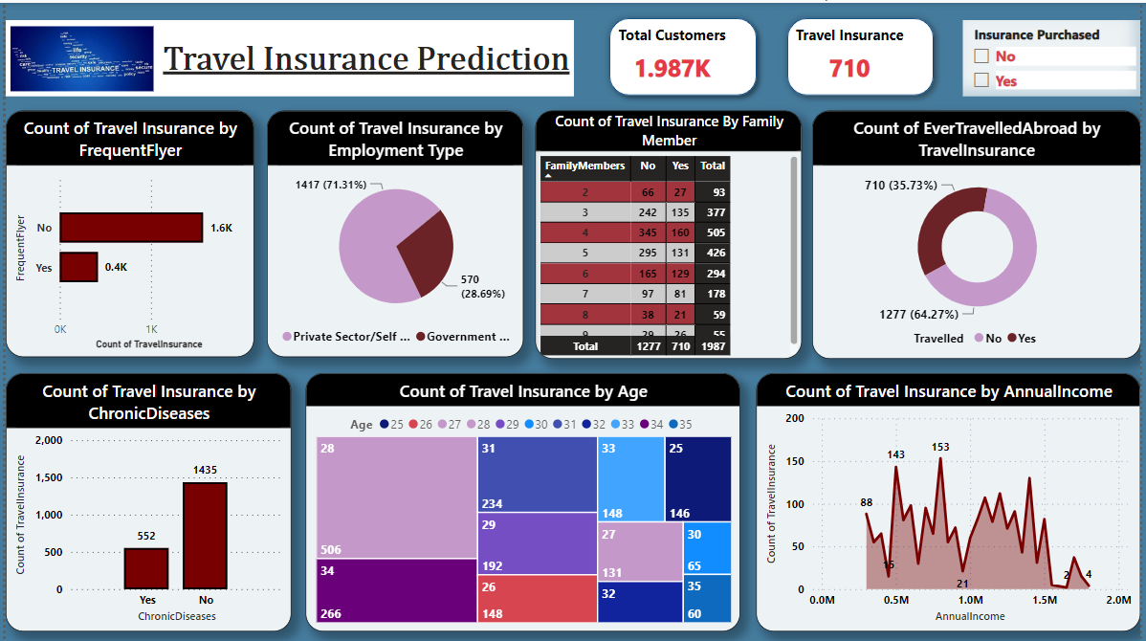
Exploring Differences through Travel Insurance Dashboard Analysis
By - Mehtaab Shaikh

Slide 19
Detail Comparison of Existing Customer
The analysis revealed that a significant portion of the current clientele comprises individuals who are not frequent flyers.
Additionally, majority of these customers are typically under 30 years of age, with annual incomes ranging between 800,000 to 1,250,000 INR, and household sizes varying from four to six members. and have not traveled abroad.
64.27% of the company's current customers opted not to purchase travel insurance.
Among 1570 customers, 417 were frequent flyers.
A total of 710 customers have travel insurance.
Out of 380 customers who traveled abroad, only 298 chose to purchase travel insurance.
Customers with an annual income of 14,00,000 have the highest number of travel insurance purchases based on the provided data.
Among 552 customers with chronic diseases, 298 acquired travel insurance.
Individuals in the private sector exhibit the highest propensity to purchase travel insurance compared to the government sector.
The highest age among customers purchasing travel insurance is 34 years.
Notably the largest segment of purchaser of the travel insurance plan had no history of travelling abroad and were not frequent Flyer.
79% are not frequent fliers, out of which 23.7% has purchased Travel Insurance.
By - Mehtaab Shaikh

Slide 20
Recommendation
According to the results, there's an opportunity to convert some non-buyers into subscribers by implementing the following suggestions:
Price Adjustment for Affordability
Introduction of Tiered Premiums
Chronic Disease Add-On
Evaluate the feasibility of offering Chronic Disease coverage as an add-on feature with a separate premium. This targeted addition can address the specific health concerns of customers and provide a valuable option for those seeking comprehensive coverage.
Family Tier Discount
Consider the introduction of a family tier that offers coverage for up to five family members at a discounted rate. This family-oriented approach not only promotes inclusivity but also provides an economic incentive for families to opt for travel insurance as a collective unit.
By implementing these recommendations, the company can potentially attract a broader customer base, meet specific needs, and enhance the overall appeal of the travel insurance offerings.
Consider revising the pricing structure of the travel insurance package to cater to customers with an annual income under 12,50,000 INR. This adjustment can enhance affordability and potentially attract more buyers.
Explore the option of introducing an additional tiered pricing structure. This can involve creating tiers with lower premiums that are proportionate to claimable amounts. This approach provides flexibility and appeals to customers with varying coverage needs.
By - Mehtaab Shaikh

Slide 21


By - Mehtaab Shaikh

